Slide 1




NEXT GEN EMPLOYABILITY PROGRAM
Creating a future-ready workforce
Team Members
College Name
Student Name : Safrin S
Student ID : au960221243039
Arunachala College Of Engineering For Women

Slide 2

CAPSTONE PROJECT SHOWCASE
Project Title
Car Rentals Application with Django Framework
Abstract | Problem Statement | Project Overview | Proposed Solution | Technology Used | Modelling & Results | Conclusion

Slide 3
Abstract
The Car Rentals Application is designed and developed using the Django framework to provide a robust platform for managing car rental services efficiently. The application aims to streamline the process of renting vehicles for both customers and rental service providers. Key features of the application include user authentication, allowing customers to create accounts, browse available cars, make reservations, and manage their bookings. Rental service providers can manage their fleet, update car availability, and view booking details. The Django framework provides a solid foundation for building web applications, offering features such as object-relational mapping for database management, a built-in admin interface for easy content management, and a robust security system. The development process involves designing a user-friendly interface using HTML, CSS, and JavaScript, integrating backend functionalities using Python and Django, and ensuring data security and integrity through proper authentication and authorization mechanisms. Through the implementation of the Car Rentals Application, users can experience a seamless rental process, enhancing the overall efficiency and convenience of car rental services. Additionally, the modularity and scalability of the Django framework allow for future enhancements and customizations to meet evolving business requirements.
Source :

Slide 4
Problem Statement
The car rental industry is a vital component of the transportation sector, providing individuals and businesses with convenient access to vehicles for various purposes. However, existing rental processes often suffer from inefficiencies, lack of transparency, and cumbersome administrative tasks.
Source :

Slide 5
Project Overview
The Car Rentals Application project aims to develop a comprehensive web-based platform using the Django framework to facilitate efficient and transparent car rental services. The application targets both customers seeking to rent vehicles and rental service providers managing vehicle fleets. By leveraging modern web technologies and best practices in software development, the project aims to streamline the rental process, enhance user experience, and improve fleet management capabilities. The application will feature secure user authentication mechanisms to allow customers and rental service providers to create accounts, log in, and manage their profiles securely. A robust booking system will enable customers to browse available vehicles, view rental options, check pricing and availability in real-time, and make reservations seamlessly. Rental service providers will have access to a dashboard to manage bookings and update vehicle availability. Strong security measures, including data encryption, secure authentication protocols, and protection against common security threats such as SQL injection and cross-site scripting (XSS), will be implemented to safeguard user data and system integrity. The Car Rentals Application project aims to deliver a robust and user-friendly platform that revolutionizes the car rental experience for both customers and rental service providers. By incorporating key features such as streamlined booking processes, efficient fleet management tools, and robust security measures, the application seeks to set a new standard for car rental services in the digital age.
Source :

Slide 6
Proposed Solution
The proposed solution is to develop a comprehensive Car Rental Application using the Django framework. This application will offer a user-friendly platform that addresses the challenges faced by both customers and rental service providers. Key features of the proposed solution include:
User Authentication: Implement a secure user authentication system that allows customers to create accounts and rental service providers to manage their profiles.
Car Listings and Search: Provide a user-friendly interface for customers to browse available cars based on criteria such as location, date, and vehicle type. Implement search functionality to facilitate quick and efficient car selection.
Booking Management: Enable customers to make reservations directly through the platform, including selecting pickup and return dates, adding additional services (e.g., insurance), and viewing booking details. Rental service providers should have access to a dashboard to manage bookings, update availability, and handle customer requests.
Payment Integration: Integrate secure payment gateways to enable customers to make online payments for their bookings. Implement payment processing functionalities that support various payment methods and ensure the security of financial transactions.
Notifications and Alerts: Implement notification systems to send reminders to customers about upcoming bookings, notify rental service providers of new reservations, and send alerts for any changes or updates to bookings.
Source :

Slide 7
6.Admin Dashboard: Develop an admin dashboard for rental service providers to manage their fleet, update car information, monitor bookings, and generate reports on rental activities.
7.Feedback and Reviews: Allow customers to provide feedback and reviews after completing their rental experience. Implement a rating system to help other users make informed decisions when selecting vehicles.
By developing a Car Rental Application with these features, the proposed solution aims to streamline the rental process, enhance customer satisfaction, and improve operational efficiency for rental service providers. This centralized platform will offer a seamless experience for renting cars, ultimately benefiting both customers and rental businesses.
Source :

Slide 8


Technology Used
Front-end
Back-end
Source :

Slide 9
Modelling & Results
Modeling:
User Model: Django provides a built-in User model, which you can extend to include additional fields like profile_picture, contact_number, etc. This model will handle authentication and authorization.
Car Model: Create a model to represent cars available for rental. This model could include fields such as make, model, year, price_per_day, availability, and image.
Booking Model: Design a model to manage bookings. This could include fields like customer (ForeignKey to the User model), car (ForeignKey to the Car model), pickup_date, return_date, total_price, and status (to track booking status).
Payment Model: If you're handling payments within your application, create a model to represent payments. This could include fields like booking (ForeignKey to the Booking model), amount, payment_method, status, etc.
Review Model: Allow users to leave reviews for cars they've rented. Create a model with fields like user, car, rating, comment, and date.
Results:
User Authentication: Users can sign up, log in, and manage their profiles. This ensures secure access to the platform.
Car Listings: Users can browse available cars, view details, and filter by various criteria such as location, date, and type.
Booking Management: Users can make reservations by selecting pickup and return dates, adding optional services, and viewing booking details. Rental service providers can manage bookings, update availability, and handle customer requests through the admin dashboard.
Payment Integration: Users can make secure online payments for their bookings using integrated payment gateways.
Admin Dashboard: Rental service providers can manage their fleet, update car information, monitor bookings, and generate reports on rental activities through the admin dashboard.
Feedback and Reviews: Users can leave feedback and reviews, helping others make informed decisions. Ratings and comments provide valuable insights into the rental experience.
Source :

Slide 10
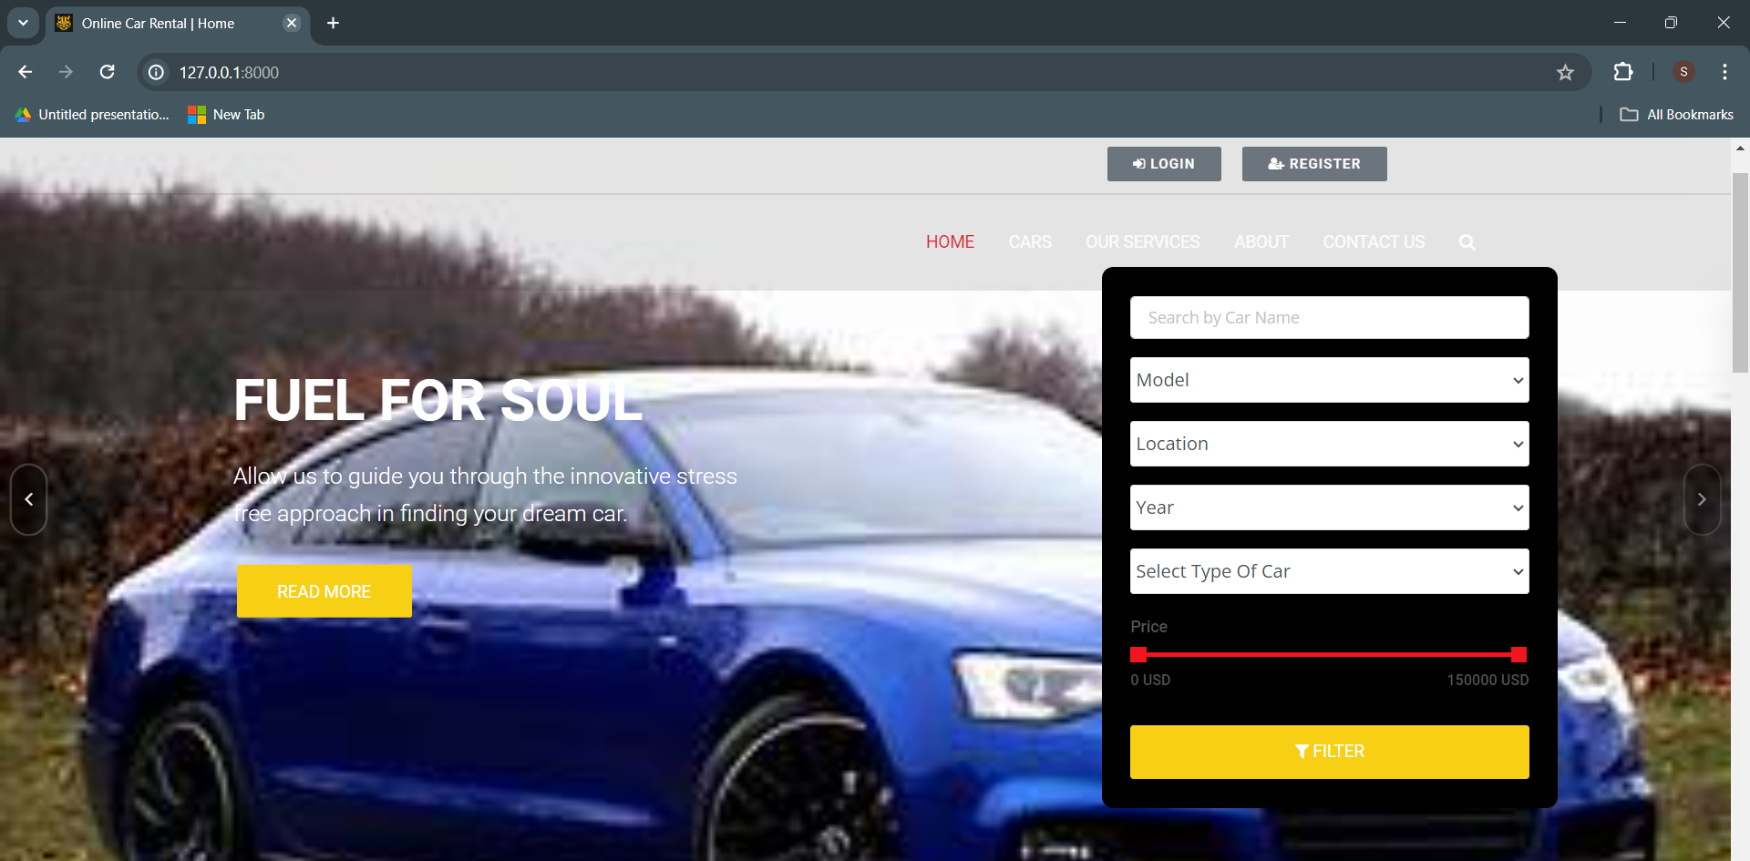
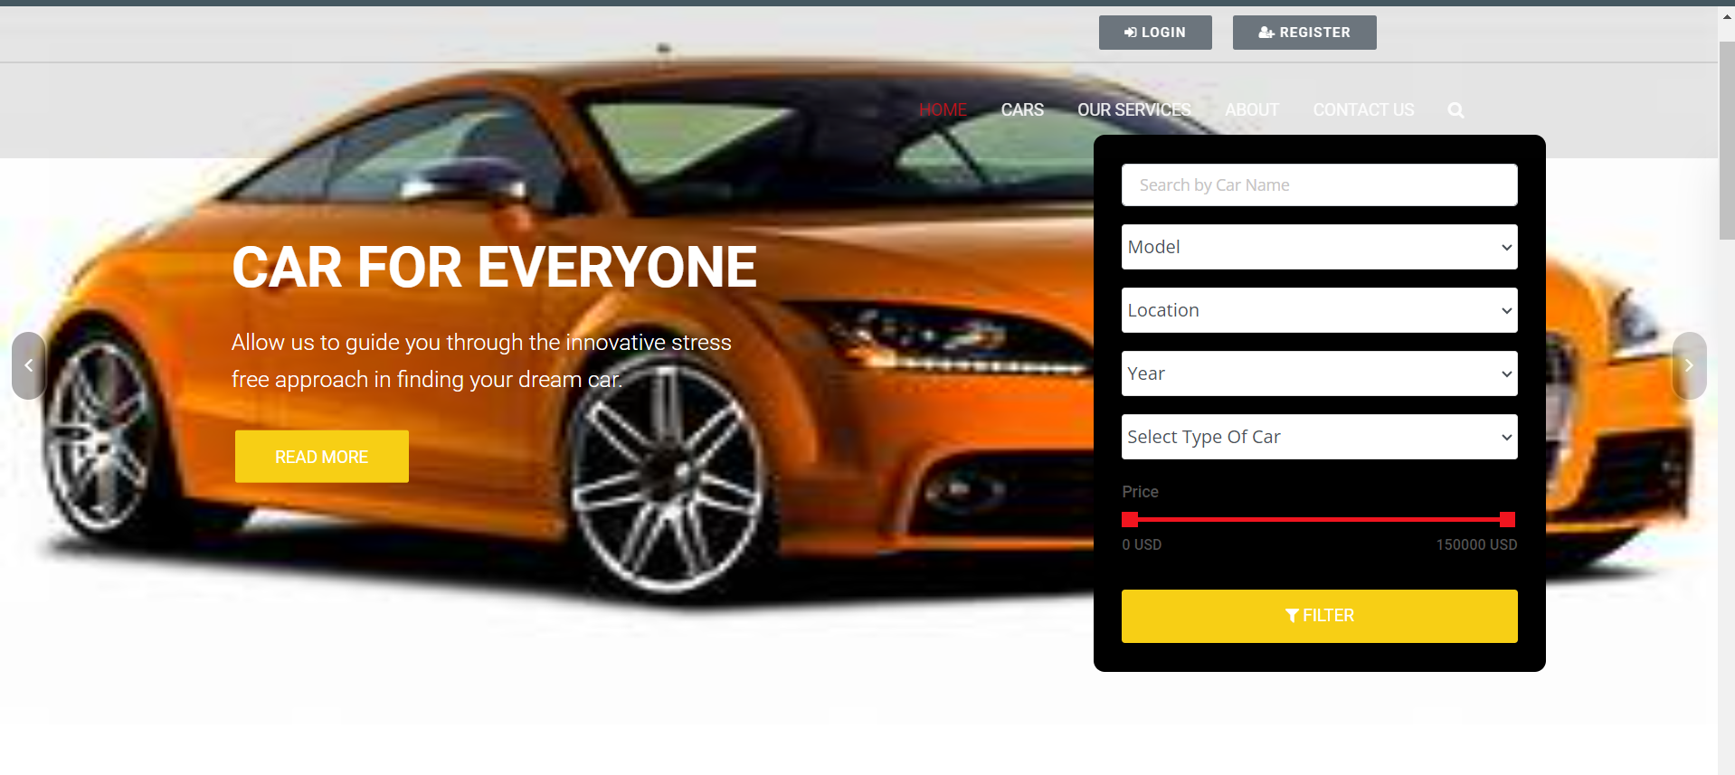
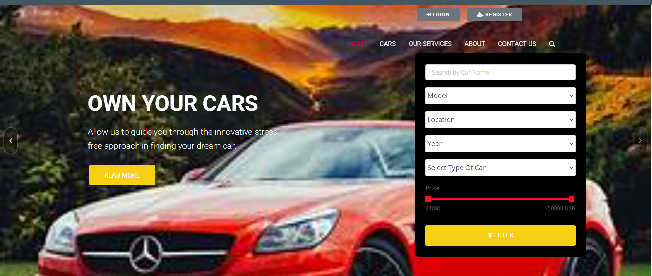
Homepage

Slide 11
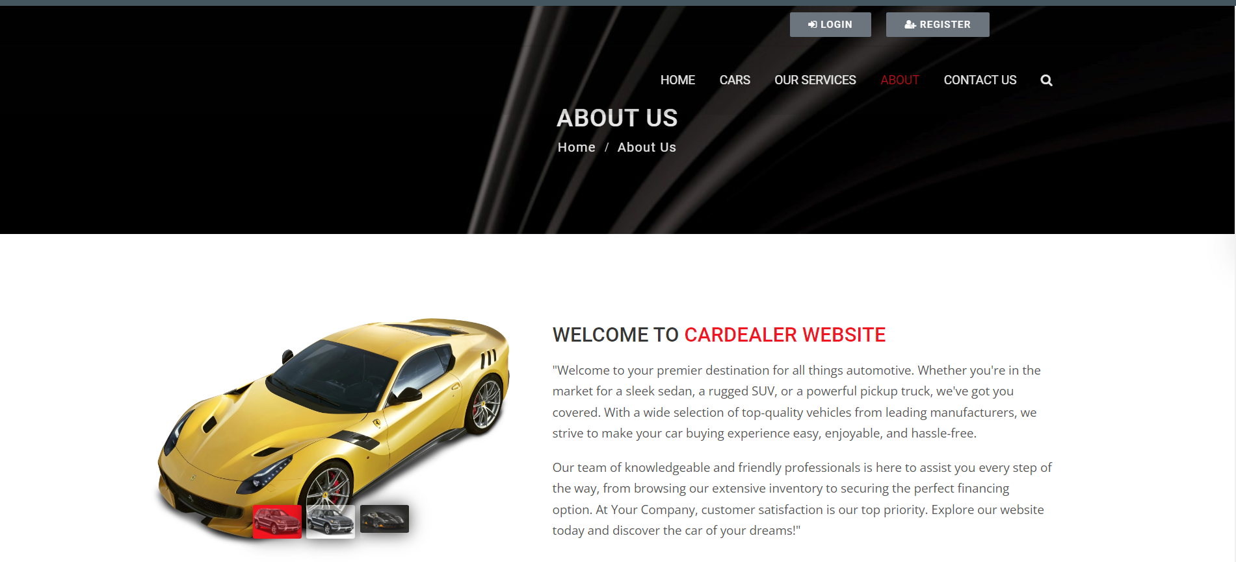
About-Us-Page

Slide 12
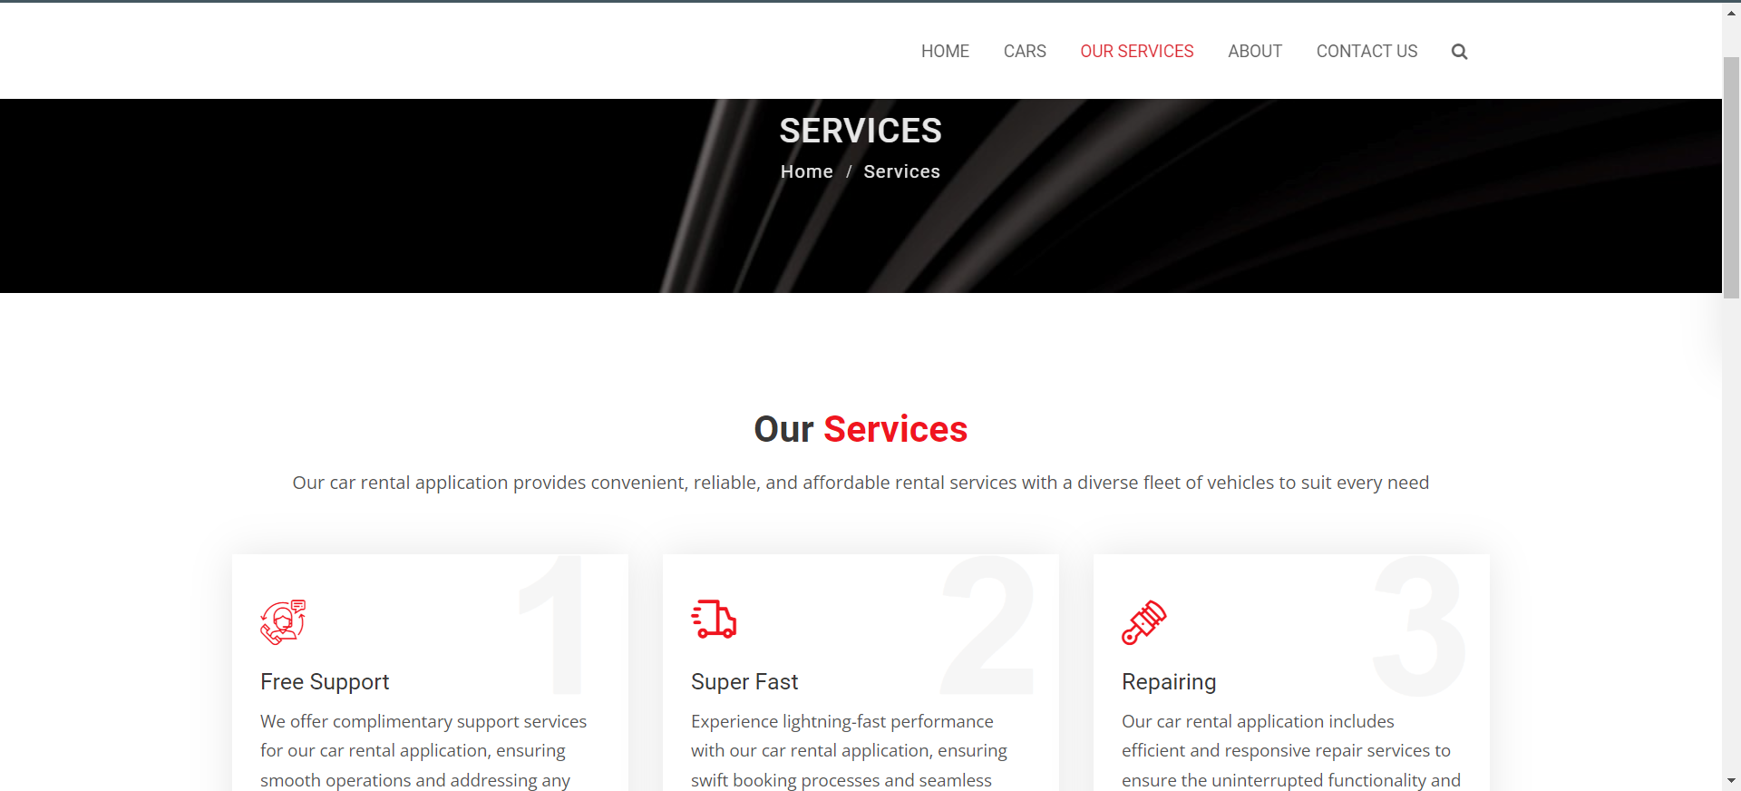
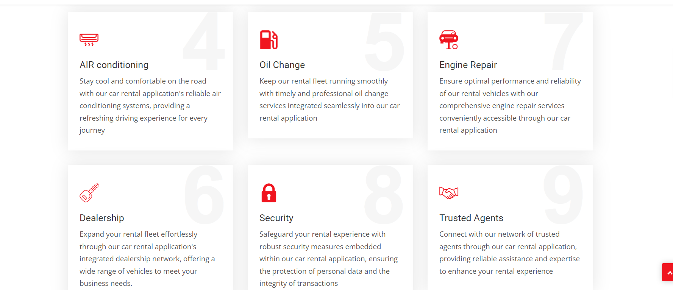
Service-Page

Slide 13
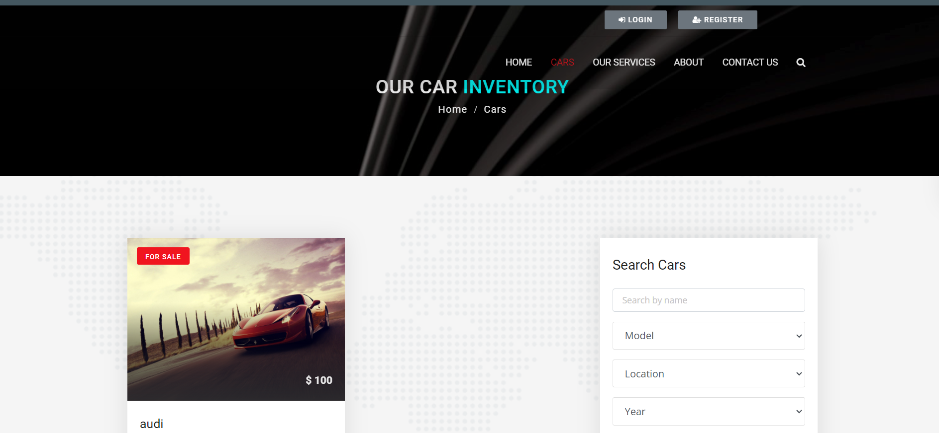
Departments-Page

Slide 14
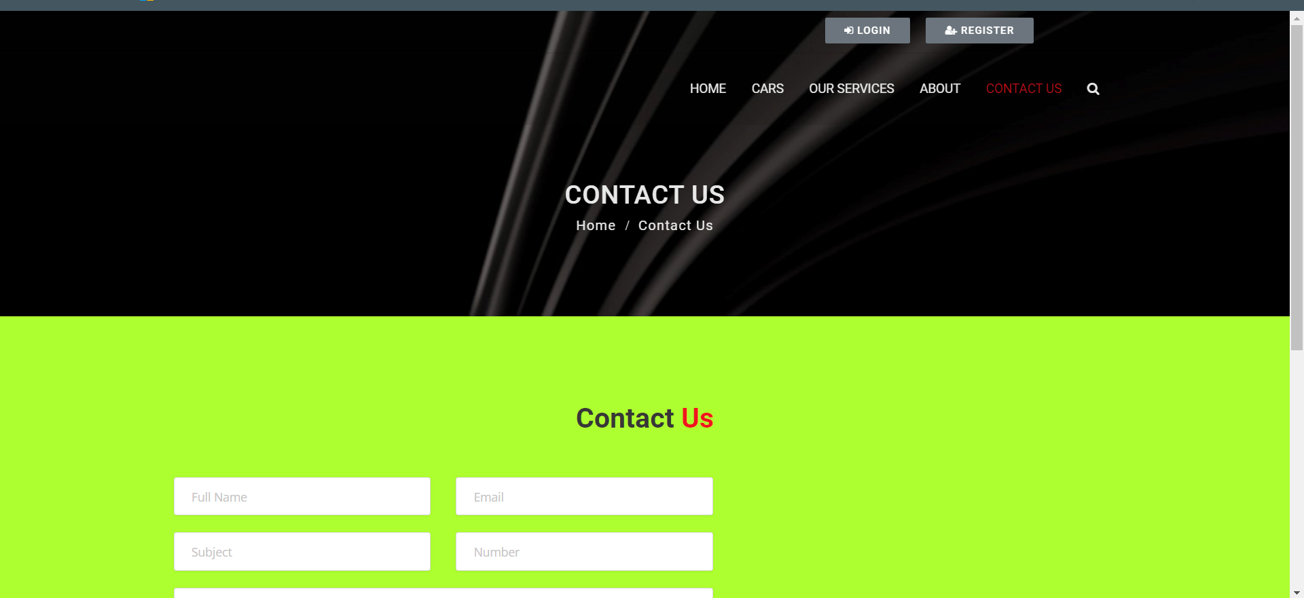
Blog-Page

Slide 15
Future Enhancements:
Advanced Vehicle Tracking: Implementing GPS technology to provide real-time tracking of rental vehicles. This could help customers locate vehicles easily and enable the rental company to monitor the vehicle's location and status.
Integration with Smart Devices: Compatibility with smart devices like smartwatches and voice assistants for seamless booking and management of rentals. Customers could book a car using voice commands or receive notifications on their wearable devices.
Personalized Recommendations: Utilizing machine learning algorithms to analyze customer preferences and past rental history to offer personalized vehicle recommendations. This could enhance customer satisfaction and increase repeat bookings.
Contactless Rental Experience: Expanding contactless features to the entire rental process, including digital contracts, keyless entry systems, and remote vehicle access through mobile apps. This could streamline the rental process and improve customer safety and convenience.
Enhanced Mobile App Features: Adding features such as virtual vehicle inspection, mobile payment options, roadside assistance requests, and real-time customer support chatbots to the mobile app. These features could enhance the overall user experience and increase customer engagement.
Integration with Mobility Services: Partnering with ride-sharing services or public transportation systems to offer integrated mobility solutions. This could allow customers to seamlessly switch between different modes of transportation and create more flexible travel options.
Green Vehicle Options: Introducing a selection of eco-friendly vehicles, such as electric or hybrid cars, to cater to environmentally conscious customers. Providing incentives or discounts for choosing these vehicles could encourage sustainable travel practices.
Expanded Loyalty Programs: Enhancing loyalty programs with tiered rewards, exclusive benefits, and partnerships with other travel-related companies (e.g., airlines, hotels) to provide additional value to frequent renters.
Predictive Maintenance: Implementing predictive maintenance systems to monitor vehicle health and schedule maintenance proactively. This could minimize downtime and ensure that rental vehicles are always in optimal condition.
Augmented Reality (AR) Assistance: Integrating AR technology into the mobile app to provide on-demand assistance with vehicle operations, navigation, and troubleshooting. This could help users familiarize themselves with unfamiliar vehicles and improve overall customer satisfaction.

Slide 16
Conclusion
In conclusion, the future of car rental applications is poised for exciting advancements aimed at enhancing convenience, safety, and sustainability for users. With the integration of cutting-edge technologies such as advanced vehicle tracking, smart device compatibility, and predictive maintenance systems, rental companies can offer seamless and personalized experiences to their customers. The expansion of contactless rental features, green vehicle options, and augmented reality assistance further reflects a commitment to innovation and meeting evolving customer needs. By embracing these enhancements, car rental applications can not only streamline operations but also foster greater customer satisfaction and loyalty in an increasingly competitive market.
Source :

Slide 17
Thank You!
Notes:
Thank You !!

